Slide 1
GROUP 2: STUDENTS’ GPA PREDICTION
By Gerald Bwanika, Ivan Kitakule and Arnold Beeka

Slide 2
GOAL OF THE MODEL
The model predicts students’ GPA basing on different features like the students’ weekly study time in hours, parents education level, parents involvement in students’ academics and many others.

Slide 3
INSIGHTFUL VISUALIZATIONS FROM THE DATA
The slides below contain insightful visualizations on the data;

Slide 4
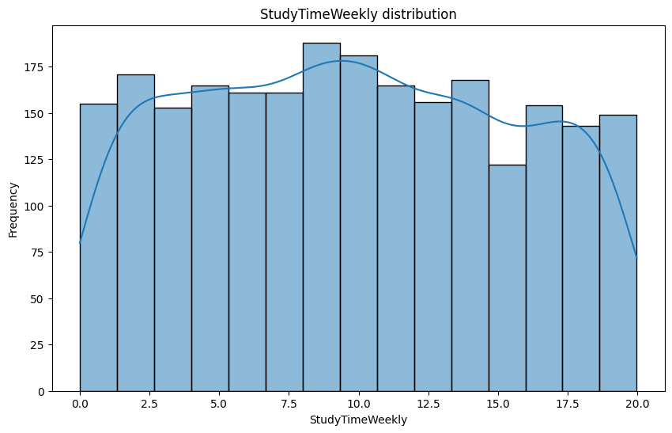
Distribution of Weekly Study Time

Slide 5
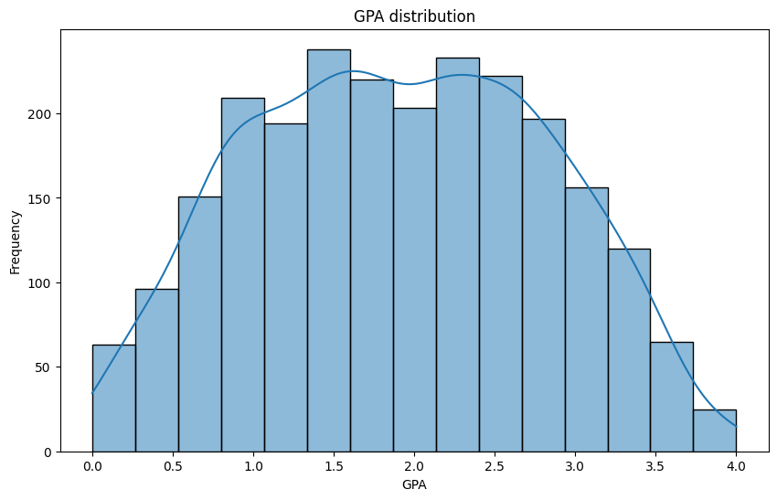
Distribution of GPA

Slide 6
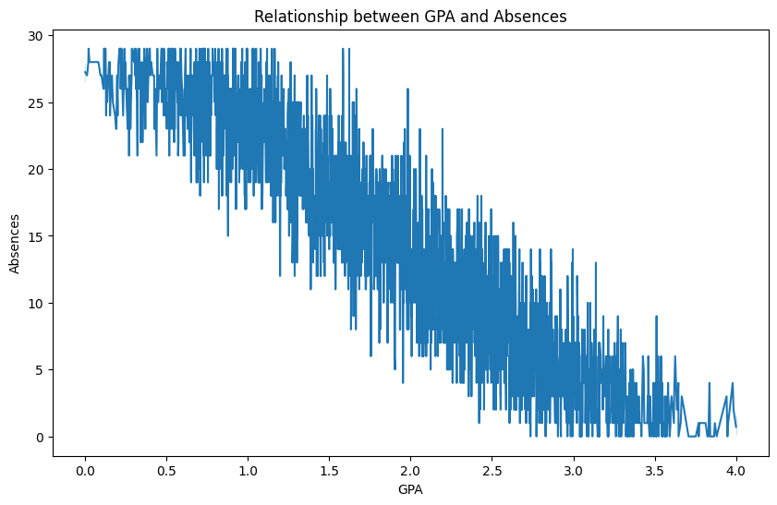
Relationship between GPA and absences

Slide 7
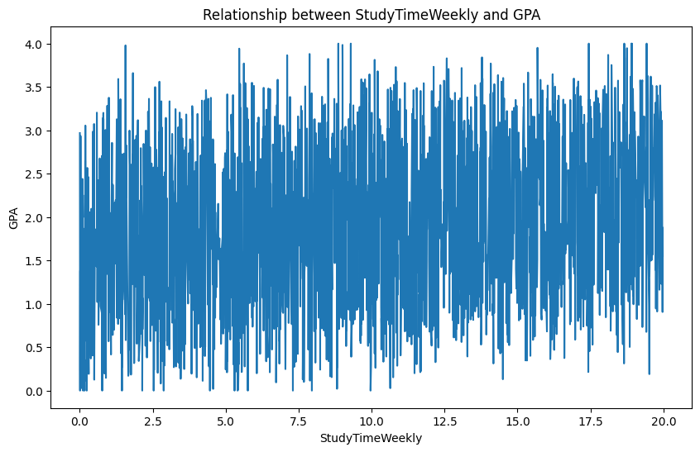
Relationship between Weekly Study Time and GPA

Slide 8
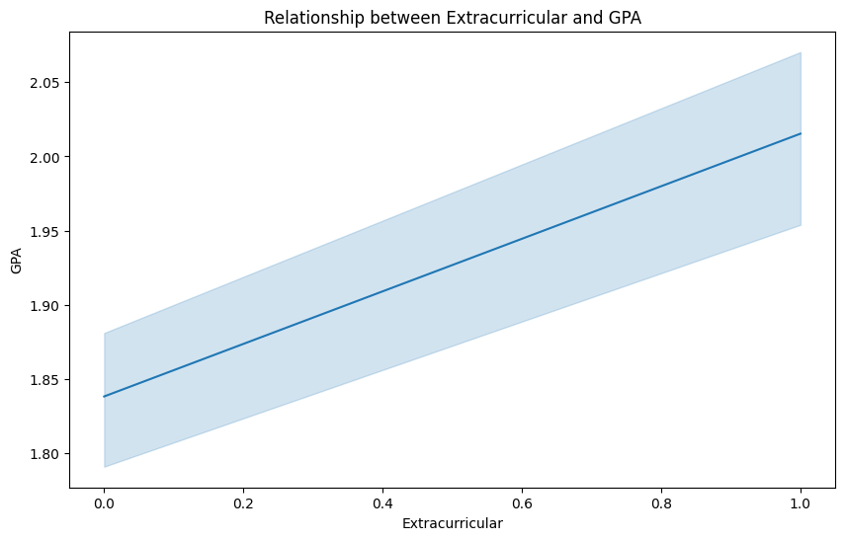
Relationship between Extracurricular and GPA

Slide 9
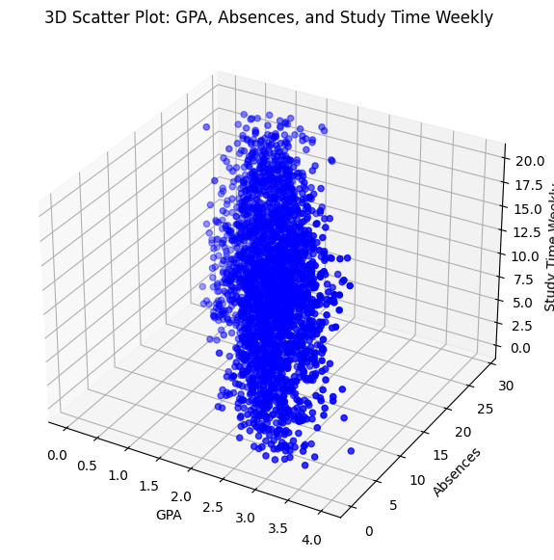
Relationship between Absences, Weekly Study Time and GPA

Slide 10
INSIGHTS FROM THE DATA
Several students have low GPAs, namely below 3.00.
The education level of students’ parents does not show a significant influence on the GPA obtained by students.
The level of parental support greatly influences students’ GPA. The higher the attention and support of parents, the higher the student’s GPA.
A student’s attendance level has a significant influence on their GPA.
The higher the student’s absenteeism rate, the lower the GPA obtained. Student study hours show a positive correlation with GPA. The more time students spend studying, the higher the GPA they earn.
Even though student study hours are high, if student attendance is also high, the GPA obtained will be low.
Students who are involved in additional activities such as extracurriculars (including music and sports), extra classes, and volunteer activities tend to have high GPAs

Slide 11
PREDICTION MODELS USED
Linear Regression
Sequential Neural Network

Slide 12
INSIGHTS FROM THE LINEAR REGRESSION MODEL(Evaluation)
The mean squared error attained was 0.03866144149454255
The r2 score attained was 0.9532471681022928

Slide 13
Coefficients of the linear regression model
index | Coefficient
Age | -0.005734243241197532
Gender | 0.01051585935898134
Ethnicity | 0.0047444875290998
ParentalEducation | 0.0001251021328413076
StudyTimeWeekly | 0.02903880352236591
Absences | -0.09951730880145998
Tutoring | 0.25826154516874195
ParentalSupport | 0.14783849436228463
Extracurricular | 0.18954633905687618
Sports | 0.18499082696954056
Music | 0.15248427421419566
Volunteering | -0.005281715690179857

Slide 14
Influence of the different features on the linear regression model
Age (-0.005734):
For each additional year of age, the GPA decreases by approximately 0.0057 points, holding all other variables constant. This suggests that, with our dataset, older students tend to have slightly lower GPAs.
Gender (0.010516):
This coefficient indicates that if the student is of a certain gender (if coded as binary), being that gender is associated with an increase in GPA by approximately 0.0105 points compared to the other gender, assuming other factors remain constant.
Ethnicity (0.004744):
Similar to gender, this suggests that the student’s ethnicity is associated with a GPA increase of about 0.0047 points. This may depend on how ethnicity is encoded in your dataset (e.g., one-hot encoding).
Parental Education (0.000125):
This coefficient shows that for each additional level of parental education (if coded as a numerical scale), the GPA increases by about 0.000125 points. This indicates a very small positive effect.
StudyTimeWeekly (0.029039):
Each additional hour spent studying per week is associated with an increase in GPA by approximately 0.029 points. This emphasizes the positive impact of study time on academic performance.
Absences (-0.099517):
Each absence is associated with a decrease in GPA of about 0.0995 points. This suggests that more absences negatively impact academic performance significantly.

Slide 15
More on influence of the different features
Tutoring (0.258262):
Each hour of tutoring is associated with an increase in GPA of approximately 0.258 points. This highlights the importance of tutoring in improving students' academic performance.
Parental Support (0.147838):
Increased parental support is associated with a GPA increase of about 0.148 points, indicating that students who receive more support from their parents tend to perform better academically.
Extracurricular Activities (0.189546):
Participation in extracurricular activities is associated with a GPA increase of approximately 0.190 points, suggesting that engaging in such activities may positively influence academic performance.
Sports (0.184991):
Involvement in sports is associated with an increase in GPA of about 0.185 points, indicating that being active in sports can contribute to better academic performance.
Music (0.152484):
Participation in music-related activities is associated with an increase in GPA of around 0.152 points, highlighting the positive effects of engagement in music on academic success.
Volunteering (-0.005282):
This coefficient indicates that volunteering is associated with a very slight decrease in GPA (about 0.0053 points), suggesting that it may not have a significant impact on academic performance in this dataset.

Slide 16
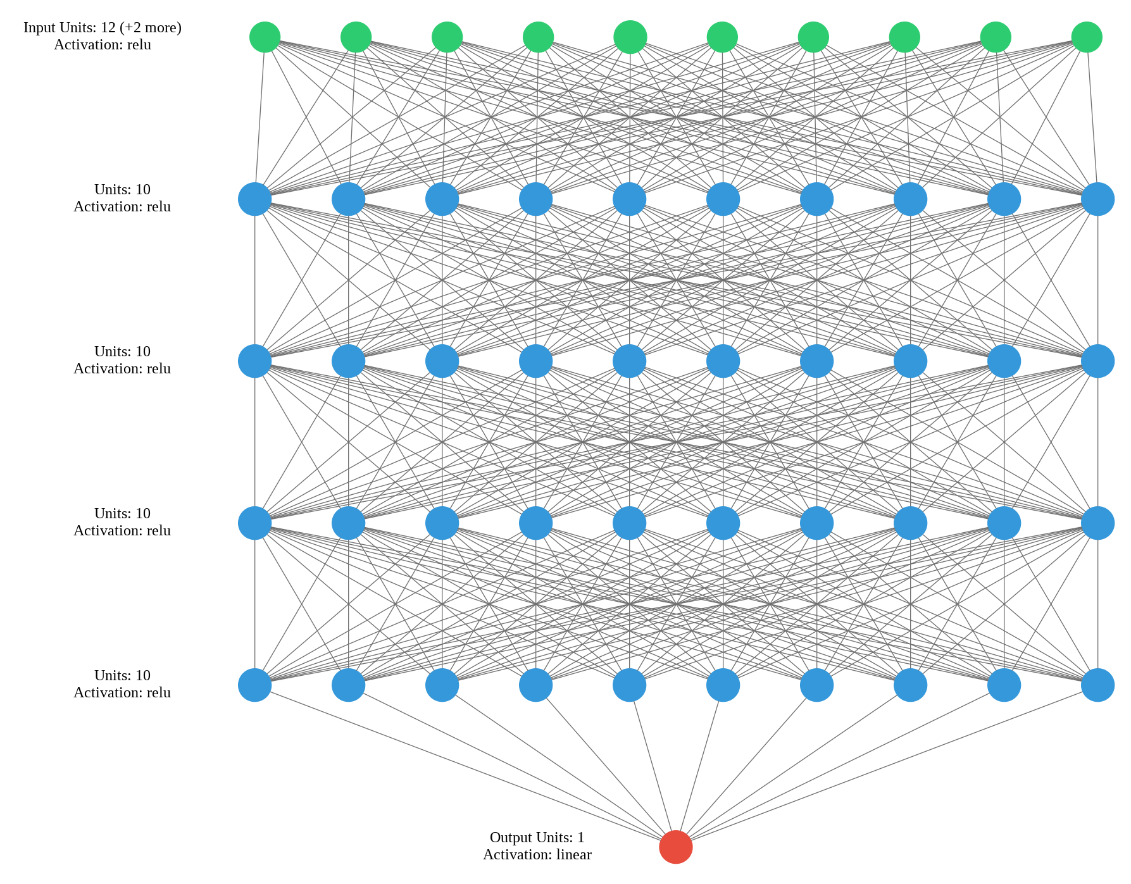
INSIGHTS FROM THE SEQUENTIAL NEURAL NETWORK

Slide 17
Evaluation outcomes of the Sequential Neural Network
The mean squared error attained is 0.04495909810066223
The mean absolute error attained is 0.1677456498146057
The root mean squared error is 0.21203561127185822
The r2 score attained was 0.9456192255020142

Slide 18
Comparison of the models
Using the r2 score value and mean square error, the linear regression model performed better than the sequential neural network.

